Slide 1
Worst things lurking in your code
Kathleen Dollard
Microsoft
Kathleen.Dollard@microsoft.com
Twitter: KathleenDollard

Slide 2

What’s the worst thing lurking in your code?

Slide 3
Zombie code Kevlin Henny https://www.infoq.com/news/2017/02/dead-code
Re: Knight CapitalGroup
This bankruptcy-defining event arose from a perfect storm. In anticipation of a new NYSE system, to be launched on the 1st of August, they had deployed updates to their servers. They updated their servers manually and, unbeknown to them, one of the deployments failed, leaving the old version running. To take advantage of the new NYSE system, they recycled an old flag, a flag that was no longer used but had now been repurposed to mean something different. Although it hadn’t been used in eight years, the old version of the code still had a dependency on the old flag.
The code had been dead for years, but was awakened by a change to the flag’s value. The zombie apocalypse arrived and the rest is bankruptcy.

Slide 4
Zombie code Kevlin Henny https://www.infoq.com/news/2017/02/dead-code
Re: Knight CapitalGroup – 450 million in 45 minutes
This bankruptcy-defining event arose from a perfect storm. In anticipation of a new NYSE system, to be launched on the 1st of August, they had deployed updates to their servers. They updated their servers manually and, unbeknown to them, one of the deployments failed, leaving the old version running. To take advantage of the new NYSE system, they recycled an old flag, a flag that was no longer used but had now been repurposed to mean something different. Although it hadn’t been used in eight years, the old version of the code still had a dependency on the old flag.
The code had been dead for years, but was awakened by a change to the flag’s value. The zombie apocalypse arrived and the rest is bankruptcy.

Slide 5
Zombie code Kevlin Henny https://www.infoq.com/news/2017/02/dead-code
Re: Knight CapitalGroup – 450 million in 45 minutes
This bankruptcy-defining event arose from a perfect storm. In anticipation of a new NYSE system, to be launched on the 1st of August, they had deployed updates to their servers. They updated their servers manually and, unbeknown to them, one of the deployments failed, leaving the old version running. To take advantage of the new NYSE system, they recycled an old flag, a flag that was no longer used but had now been repurposed to mean something different. Although it hadn’t been used in eight years, the old version of the code still had a dependency on the old flag.
The code had been dead for years, but was awakened by a change to the flag’s value. The zombie apocalypse arrived and the rest is bankruptcy.

Slide 6
Zombie code Kevlin Henny https://www.infoq.com/news/2017/02/dead-code
Re: Knight CapitalGroup – 450 million in 45 minutes
This bankruptcy-defining event arose from a perfect storm. In anticipation of a new NYSE system, to be launched on the 1st of August, they had deployed updates to their servers. They updated their servers manually and, unbeknown to them, one of the deployments failed, leaving the old version running. To take advantage of the new NYSE system, they recycled an old flag, a flag that was no longer used but had now been repurposed to mean something different. Although it hadn’t been used in eight years, the old version of the code still had a dependency on the old flag.
The code had been dead for years, but was awakened by a change to the flag’s value. The zombie apocalypse arrived and the rest is bankruptcy.

Slide 7

What else?
By Carol M. Highsmith - Library of CongressCatalog: http://lccn.loc.gov/2011630866Image download: https://cdn.loc.gov/master/pnp/highsm/12600/12672a.tifOriginal url: http://hdl.loc.gov/loc.pnp/highsm.12672, Public Domain, https://commons.wikimedia.org/w/index.php?curid=52220198

Slide 8
Contraption Code James Gleick https://www.around.com/ariane.html
“But in this case, the programmers had decided that this particular velocity figure would never be large enough to cause trouble. After all, it never had been before. Unluckily, Ariane 5 was a faster rocket than Ariane 4. One extra absurdity: the calculation containing the bug, which shut down the guidance system, which confused the on-board computer, which forced the rocket off course, actually served no purpose once the rocket was in the air. Its only function was to align the system before launch. So it should have been turned off. But engineers chose long ago, in an earlier version of the Ariane, to leave this function running for the first 40 seconds of flight -- a "special feature" meant to make it easy to restart the system in the event of a brief hold in the countdown.”

Slide 9
Contraption Code James Gleick https://www.around.com/ariane.html
“But in this case, the programmers had decided that this particular velocity figure would never be large enough to cause trouble. After all, it never had been before. Unluckily, Ariane 5 was a faster rocket than Ariane 4. One extra absurdity: the calculation containing the bug, which shut down the guidance system, which confused the on-board computer, which forced the rocket off course, actually served no purpose once the rocket was in the air. Its only function was to align the system before launch. So it should have been turned off. But engineers chose long ago, in an earlier version of the Ariane, to leave this function running for the first 40 seconds of flight -- a "special feature" meant to make it easy to restart the system in the event of a brief hold in the countdown.”

Slide 10
Contraption Code James Gleick https://www.around.com/ariane.html
“But in this case, the programmers had decided that this particular velocity figure would never be large enough to cause trouble. After all, it never had been before. Unluckily, Ariane 5 was a faster rocket than Ariane 4. One extra absurdity: the calculation containing the bug, which shut down the guidance system, which confused the on-board computer, which forced the rocket off course, actually served no purpose once the rocket was in the air. Its only function was to align the system before launch. So it should have been turned off. But engineers chose long ago, in an earlier version of the Ariane, to leave this function running for the first 40 seconds of flight -- a "special feature" meant to make it easy to restart the system in the event of a brief hold in the countdown.”

Slide 11
Contraption Code James Gleick https://www.around.com/ariane.html
“But in this case, the programmers had decided that this particular velocity figure would never be large enough to cause trouble. After all, it never had been before. Unluckily, Ariane 5 was a faster rocket than Ariane 4. One extra absurdity: the calculation containing the bug, which shut down the guidance system, which confused the on-board computer, which forced the rocket off course, actually served no purpose once the rocket was in the air. Its only function was to align the system before launch. So it should have been turned off. But engineers chose long ago, in an earlier version of the Ariane, to leave this function running for the first 40 seconds of flight -- a "special feature" meant to make it easy to restart the system in the event of a brief hold in the countdown.”

Slide 12
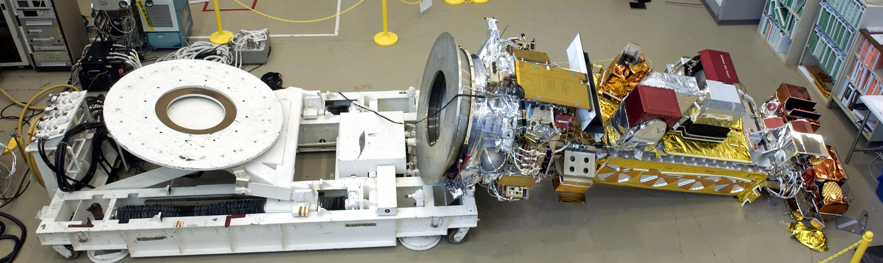
Sloppiness
$135M
24 bolts

Slide 13
Solution is not to rewrite the code
Respect the code and the coders
Add basics that support stability, like testing and tracing
Fix bugs thoughtfully
Be vigilant on dead, spurious, unused and redundant code
$135M 24 bolts

